Slide 1
CEO Office Hours
Adult and Dislocated Worker Service Provider RFP

Slide 2
Today’s Presenter
Michelle McNertney
  Michelle.mcnertney@iwd.iowa.gov

Slide 3
Purpose of Office Hours
To provide an opportunity for Chief Elected Officials (CEOs) to
  Ask questions and seek clarification regarding their tasks within the Iowa workforce system transformation
  Engage in dialogue with other CEOs and Iowa Workforce Development
To provide an opportunity for Iowa Workforce Development to
  Provide guidance or explanation on policies

Slide 4
Objectives of Office Hours
Examine timeline and upcoming dates
Review Adult and Dislocated Worker Request for Proposal (RFP) template
Provide next steps for RFP templates
Answer questions regarding CEO Transformation key tasks

Slide 5
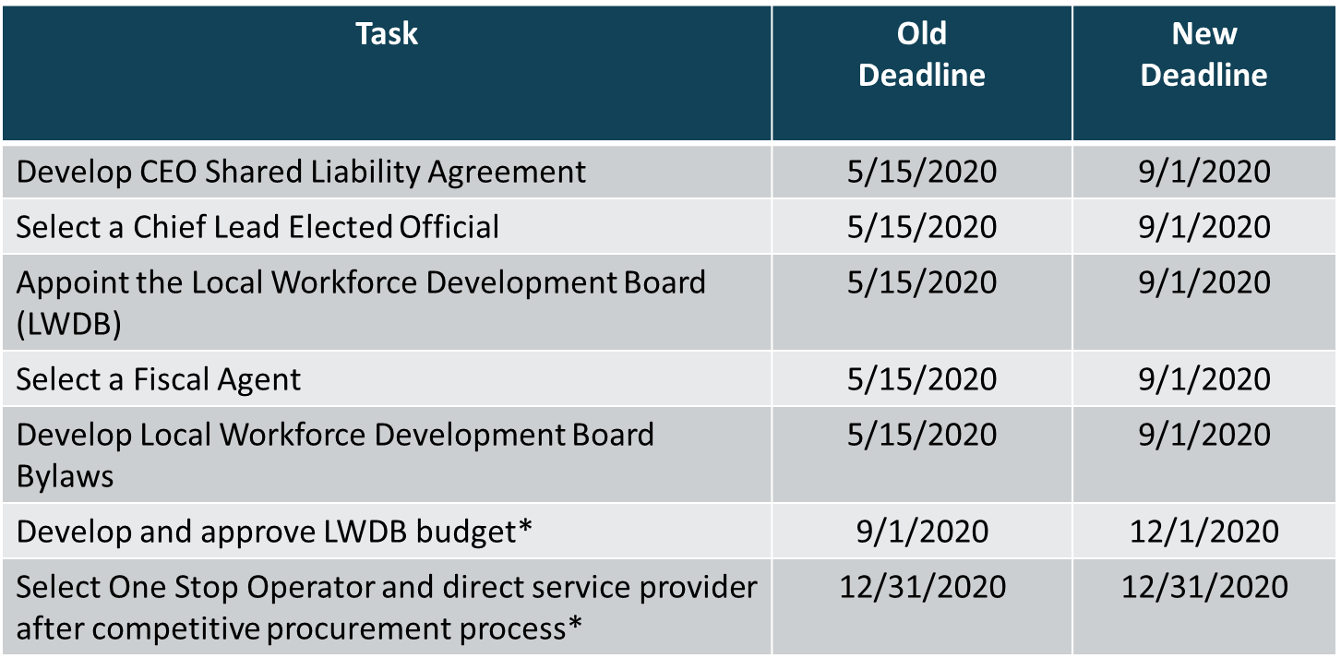
CEO Key Deliverables/ Revised Timeline

Slide 6
Adult and Dislocated Worker Service Provider RFP

Slide 7
Things to know about the RFP
This should be a joint task between the CEOs and the LWDB.
IWD Policy 1.4.8.1 requires that service providers for adult, dislocated worker and youth services be procured (current exception through 12/31/20)
You are not required to use this template
It is currently considered a draft, but we will remove the DRAFT watermark from it after this call and send the official version out to each CEO.
It was written generically and each LWDA will need to customize it. The sections which require customization are in red. (also remove SWDB logo and add yours)
Best Practices are highlighted in text boxes throughout the document

Slide 8
Sections of the RFP
Background and General Information
Procurement Process & Requirements
Statement of Work
Proposal Guidelines
Terms and Conditions
Appendices

Slide 9
Section I- Background and General Information- page 5
The specific LWDB (local workforce development board) and LWDA (local workforce development) must be noted.
Start and stop dates of the work to be done.
Identify who is the contact person for the RFP
  This will generally be the Executive Director of the LWDB. If a LWDB does not have a staff person, one person will need to be agreed upon.
Page 7- IWD will provide to the CLEO the estimated amount of adult and dislocated worker funding for the upcoming year. The amount available to a contractor for services must be noted in the box on page seven (7).

Slide 10
Section II- Procurement Process & Requirements- page 8
In your copy of the proposal, this section is called Submission Requirements, but in the final version it will be Procurement Process & Requirements.
This is where you outline what is expected of bidders during the procurement process.
  Things presented here are optional; however, it is a good idea to think through all of these issues
Bidders’ Conference- a common way to answer questions during a bid process

Slide 11
Section III- Statement of Work- p. 12
This section outlines the bidders’ approach to providing adult and dislocated worker services
  Identify location of IowaWORKS offices where services will be delivered
  Covers topics such as
    Integrated services- how they’ll work within the already established system
    Outreach and Branding
    Enrollment
    Career Services- basic, individualized, follow up
      Workshops
    Training Services
    Supportive Services
    Rapid Response
    National Dislocated Worker Grants, TAA, Other grant opportunities
    Business Services
    Staff Training and Development
    Performance Indicators and Goals- required, optional
      Poor performance
    Data Management and Reporting
      Data Management System
      Records and Documentation
    Contract Oversight and Evaluation
      Contractor Responsibilities
      Subcontracts
    Additional Program Requirements

Slide 12
Subcontractors
CEOs and the LWDB will decide if the service provider can have a subcontractor
  Things to consider
    An entity providing a bid to be a service provider should identify subcontractors within their proposal for services.

Slide 13
Section IV- Proposal Guidelines- p. 26
Proposal requirements- narrative and budget
  This is what the bidders will use to develop their proposal. It tells the questions to be answered and the topics to cover.
  Budget and Budget Narrative
  Review and Selection Process
    Outlines how proposals will be evaluated
    Provides a timeline for entire process- page 32
  Provisions- additional information and disclaimers regarding the process

Slide 14
Section V- Terms and Conditions- p. 34
Standard terms and conditions for a bid process
  Requires liability insurance- p. 35

Slide 15
Appendices
Appendix A- Cover sheet to be used by bidders
Appendix B- Budget Sheets
Appendix C- Assurances and Certifications
Appendix D- Evaluation Criteria
Appendix E-Estimates of Fixed Costs per Center

Slide 16
Appendix B- Budget Sheets
Budget Summary- this is a roll up chart of all the budget detail charts
  Budget Detail
    Salary Detail
    Personnel Benefit Detail
    Mileage Detail
    Travel Detail
    Direct Cost Detail
    Profit Cost Detail
    Participant Costs- Training
    Participant Costs- Support
    Participant Costs- Work Experience
  Budget Summary, Detail and Narrative Instructions

Slide 17
Direct Cost Detail
Line Item | Amount Requested
Materials & Supplies (Non-Training Related) | $
Telephone | $
Postage | $
Rent | $
Utilities | $
Maintenance | $
Bond | $
Advertising | $
Audit | $
Other (Specify) | $
Other (Specify) | $
Total Direct Costs | $
IWD will work with you to provide estimates on these costs per center
  Based on actual costs from current service providers

Slide 18
Appendix C- Assurances and Certifications
Signatory for bidding organization must sign attesting to these conditions.

Slide 19
Appendix D- Evaluation Criteria- p. 45
Evaluation of each proposal is based on the following
  Ability of the program to help the {insert name here} meet performance goals
  Reasonableness and affordability of the unit price
  How well the program will collaborate with other organizations in the community
  Organizational capacity and experience in providing programs for Adult and Dislocated Workers

Slide 20
Questions?

Slide 21
Contact
      WIOAgovernance@iwd.iowa.gov
      Michelle.mcnertney@iwd.iowa.gov
      Linda.rouse@iwd.iowa.gov
      Michael.witt@iwd.iowa.gov

Slide 22
Next Office Hours
Friday, May 15
12:00 pm

Slide 23
Thank You!

